Slide 1
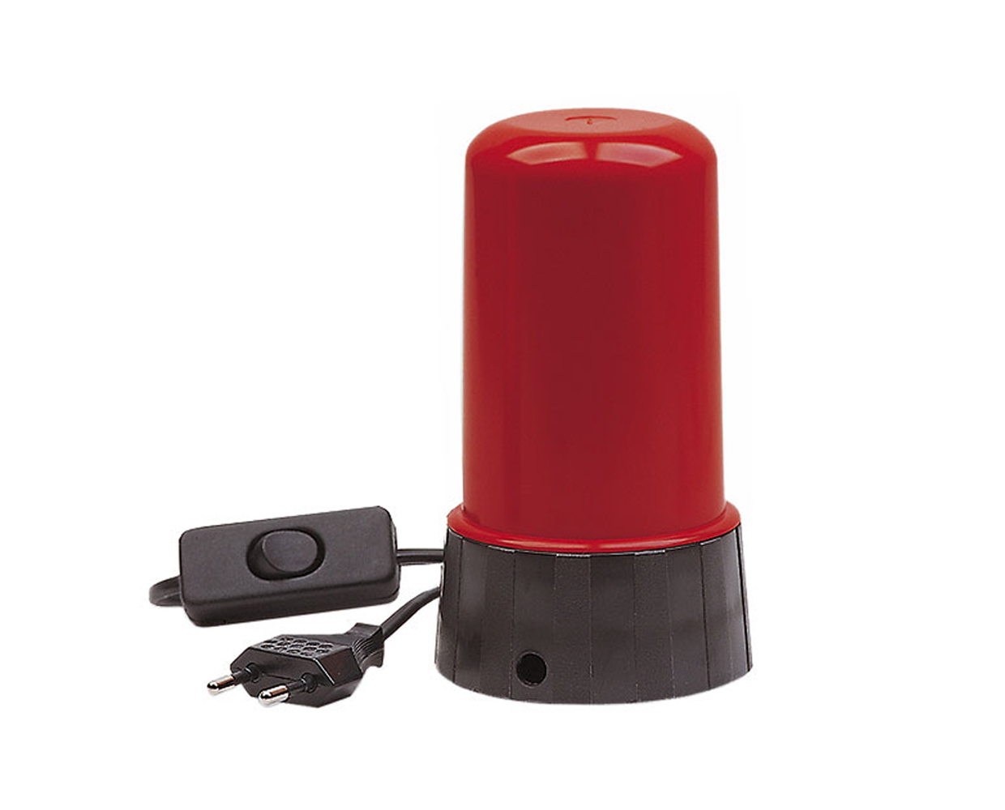
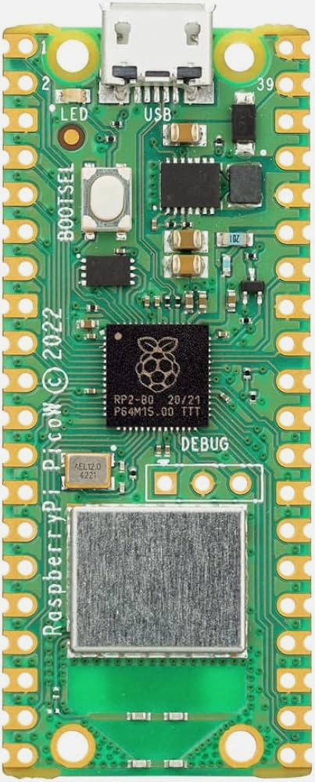

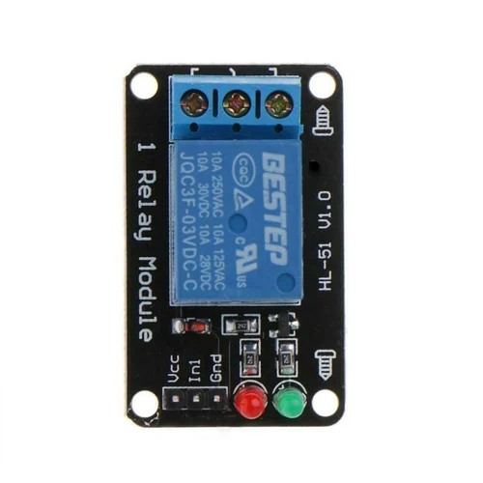
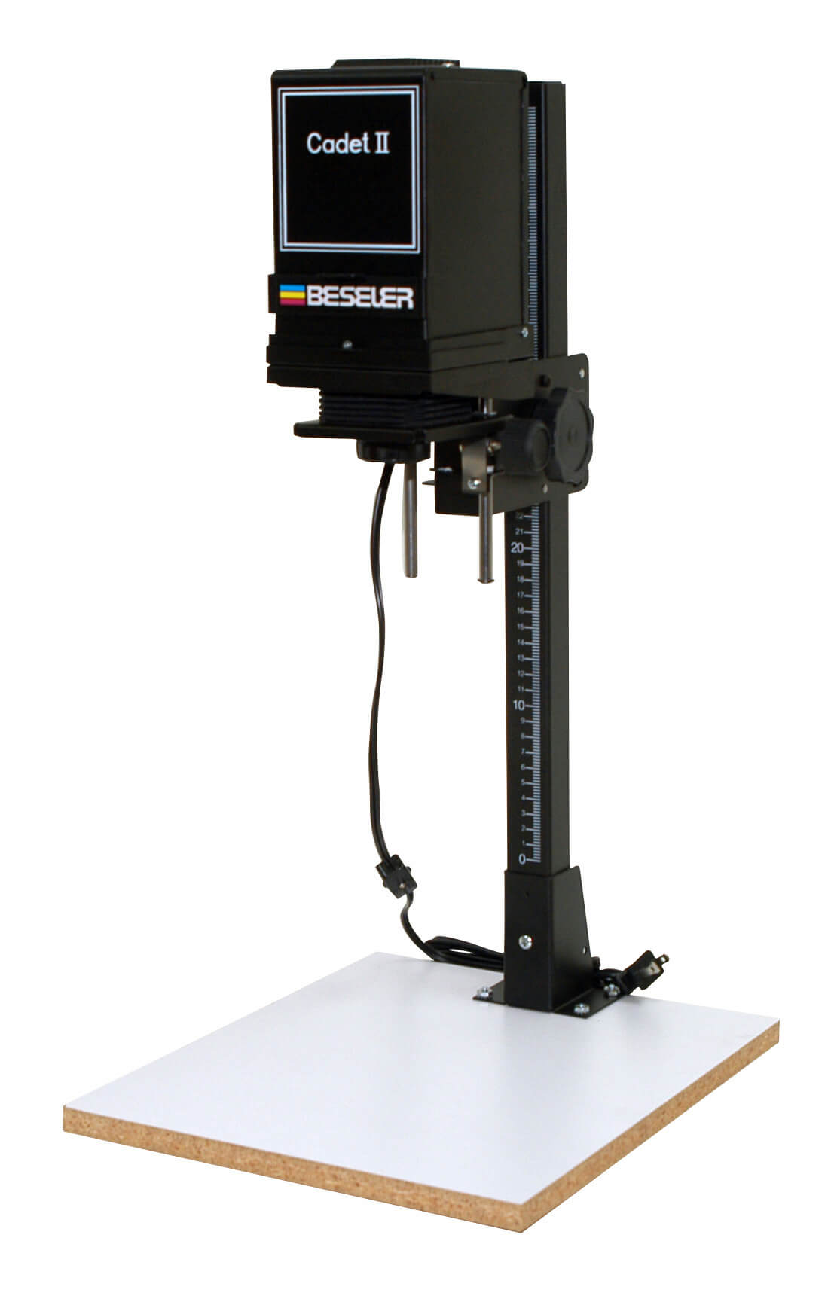
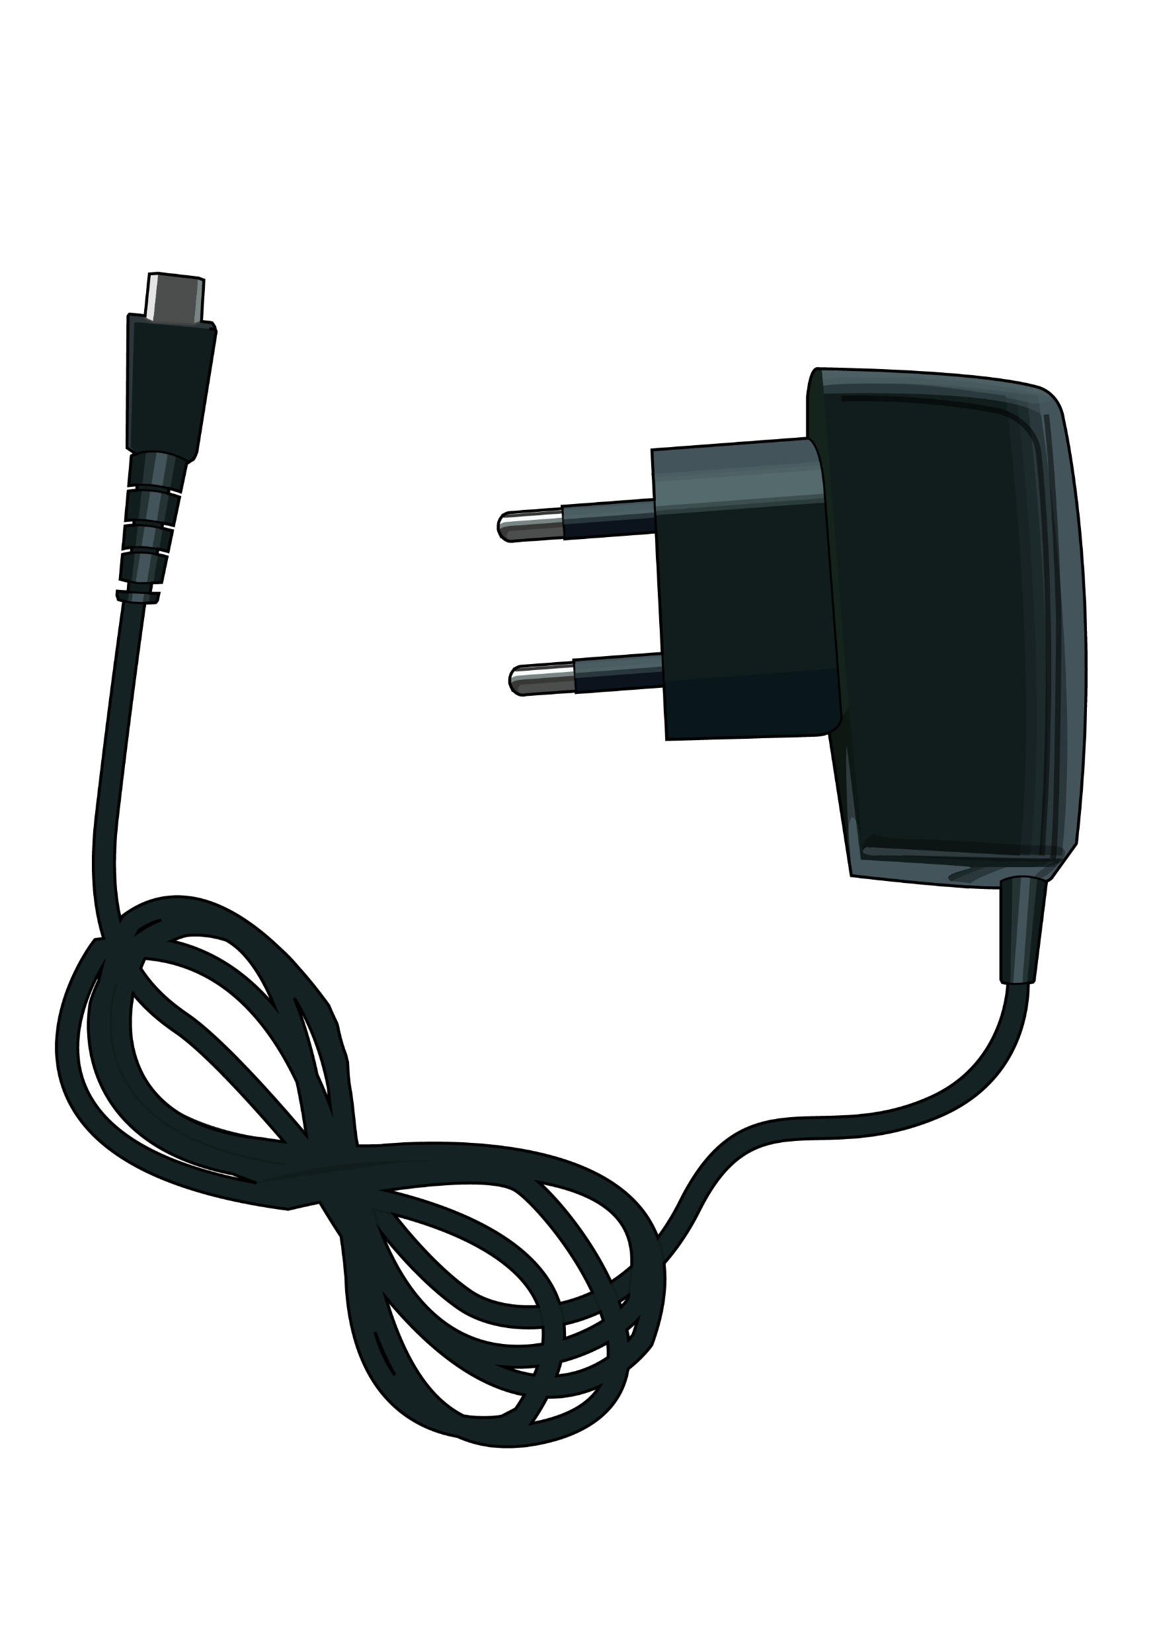


Raspberry Pico W
Safety light (optional)
3.3V Relay
1 channel
DC 1,8-5,5V
Ampliadora
DisparaTimer
AC 125-250V

Slide 2
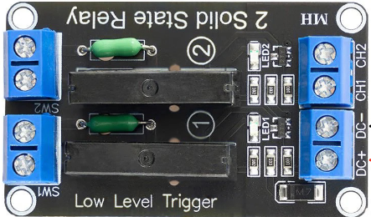
Raspberry Pico W
Safety light (optional)
Solid state Relay
2 channels
DC 1,8-5,5V
Enlarger
DisparaTimer
AC 125-250V

